Slide 1
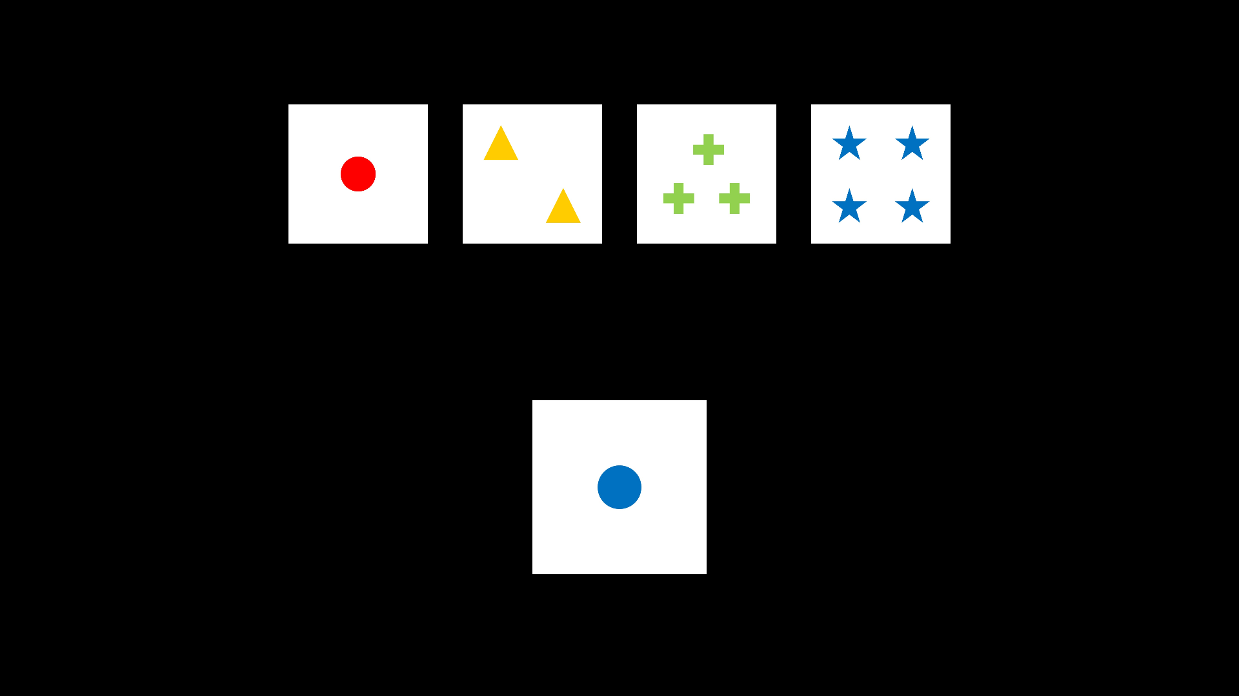
Wisconsin Card Sorting Task
Categories
Card to-be-sorted
3 sorting rules: colour, shape or number

Slide 2


Wisconsin Card Sorting Task
Answers for different sorting rules
colour
shape
number
Sorting rule switches after 4 to 6 cumulative correct responses

Slide 3

Colour-word Stroop Task
2 conditions:
Congruency
→ whether colour matches meaning of the word
Match
whether colour of the word on top matches
meaning of the word on the bottom
Participants respond on whether there is a match

Slide 4
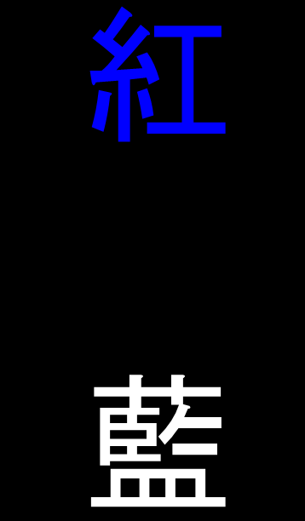
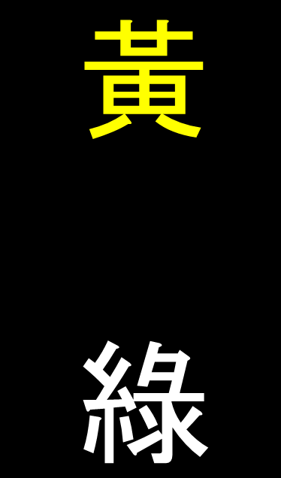
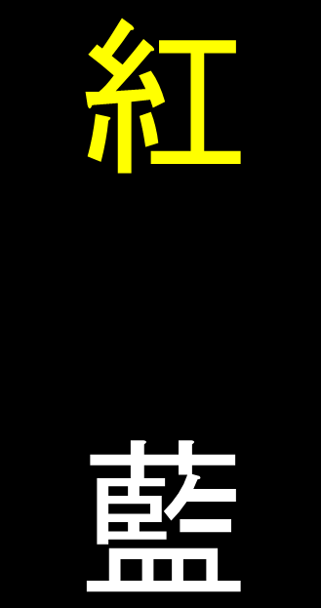
Colour-word Stroop Task
Congruent
Incongruent
Match
Not match

